Slide 1
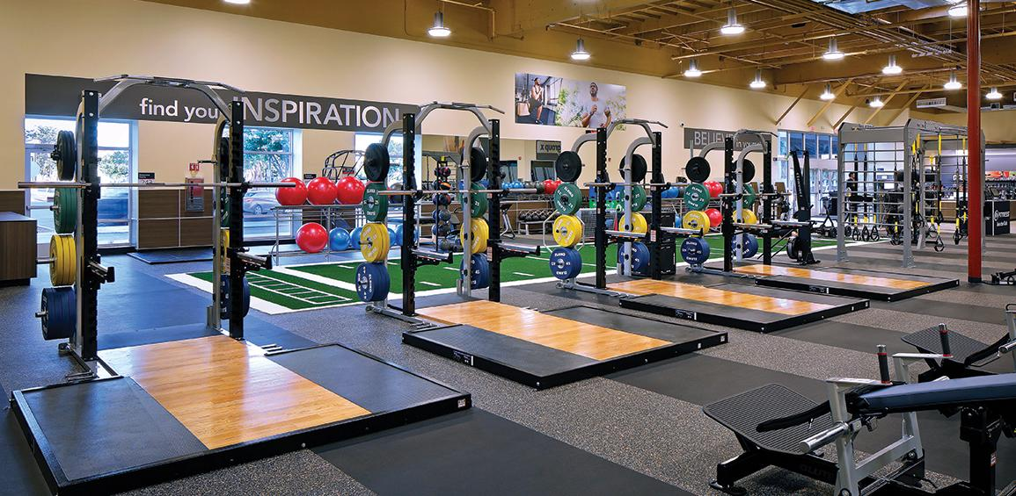
Personal Trainer Gym Chatbot
CMPE 252 Omkar Naik

Slide 2
Motivation:
More than 7 years into training interested me build this Chatbot
This Chatbot will help the society get Fit for Free AI based Personal Trainer
Helps in Keep Track for their PR so that they can improve
Calculate THE MAINTENANCE CALORIES - TDEE and gives Diet

Slide 3
Demo
Video

Slide 4
Challenges and how to overcome them
Response Time is slow for most API. So creating own API using any framework such as Node.js on localhost and then deploying it on AWS would save Time
Most API has Less number of request so difficult to Test them and The Fitness API were mainly Paid
Used SQLite instead of mysql as no packages were needed to install

Slide 5
Future Scope
Would Connect Database for each user and give them specific Diet
Connect with Google API to get all the Fitness center near by
Add workout images and videos with proper workout forms
Deploying it on Telegram

